Slide 1


Deep Learning on 3D meshes via Model Simplification Semester Project Presentation
June 4th, 2018
Presenter : Cleres David, CSE – Master 2
Supervisor: Prof. Pascal Fua & Edoardo Remelli
École Polytechnique Fédérale de Lausanne – EPFL
CVLAB
Notes:
Se présenter = David Cleres, doing my master in Computational Science & Engineering (CSE)

Slide 2
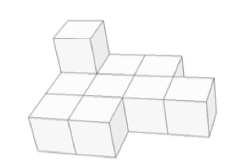
What is a Polycube?
“A polycube is a 3D shape composed of axis aligned unit cubes that are attached face to face”
Applications
Computer Graphics
Texture Mapping
Mesh Generation
Source: [Tarini et al. 2004]
Source: Yu, W., Zhang, K., Wan, S., & Li, X. (2014)
Notes:
Why is it useful?
Gives a seamless discretisation with low distorsion
Regular Atlas Structure
→ Desirable qualities for many geometric modeling tasks

Slide 3
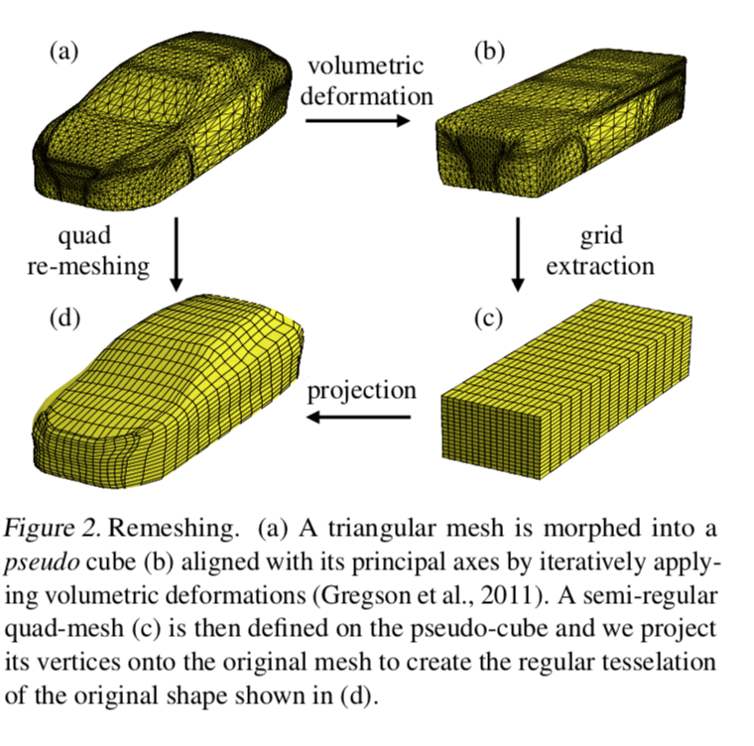
Basics in Polycube Mapping
Source: Baqué, P., Remelli, E., Fleuret, F., & Fua, P. (2018). Geodesic Convolutional Shape Optimization. Retrieved from http://arxiv.org/abs/1802.04016
Notes:
Aerodynamic shape optimization plays a major role in many applications to aircraft, cars, trains, turbines, internal pipe flows, and cavities, among others.
However, the state-of-the art methods used in industry are so computationally demanding that typical engineering practices are to either simply try a limited umber of hand-designed shapes or restrict oneself to shapes that can be parameterized using only few degrees of freedom.
The use of artificial neural networks (ANN) in order to emulate a fluidynamics simulator by training Geodesic Convolutional Neural Networks outperforms the industrial methods by 5 to 20\% for standard problems and, even more importantly and applies to cases that previous methods cannot handle. However, the generation of Polycubic structures still require important amount of resources, an issue tackled in this document by using Deep Learning to learn how to generate these simplified structures starting from a standard STL file.
The goal of this project is to explore how polycube model simplification can be utilized to perform deep learning on 3D meshes efficiently: in particular the aim is to implement a polycube mapping algorithm and create a dataset of simplified models with it. Once such data-set is created 3D CNNs can be exploited to obtain efficient solid model simplification
→ Having a simpler structure of the meshes helps to parallelize the computations on GPU and on decreases the time to perform the convolutions

Slide 4


Can we do this more efficiently?
3 different languages
Not the ideal languages for voxelization
Algorithmic complexity of the cubing process
Axis aligning
Voxelization
Hough Transform
…
…
Notes:
- 3 different languages = Python, Maltab, C++

Slide 5
Table of Content
Polycube Generation
Axis Aligning Deformation
Volumetric Voxelization
Hough Transform
Learn the Polycubing
3D U-Net
3D CNN
Notes:
- Faire une résumer de ce qu’on peut faire avec le SPA toolkit
Designed in python 2 but I upgraded it to python 3.
SPA Toolkit est la partie la plus longue du projet et donc c’est celle qui sera abordée avec le plus de details (et donc la plus longue)

Slide 6
Table of Content
Polycube Generation
Axis Aligning Deformation
Volumetric Voxelization
Hough Transform
Learn the Polycubing
3D U-Net
3D CNN
Notes:
- Faire une résumer de ce qu’on peut faire avec le SPA toolkit
Designed in python 2 but I upgraded it to python 3.
SPA Toolkit est la partie la plus longue du projet et donc c’est celle qui sera abordée avec le plus de details (et donc la plus longue)

Slide 7
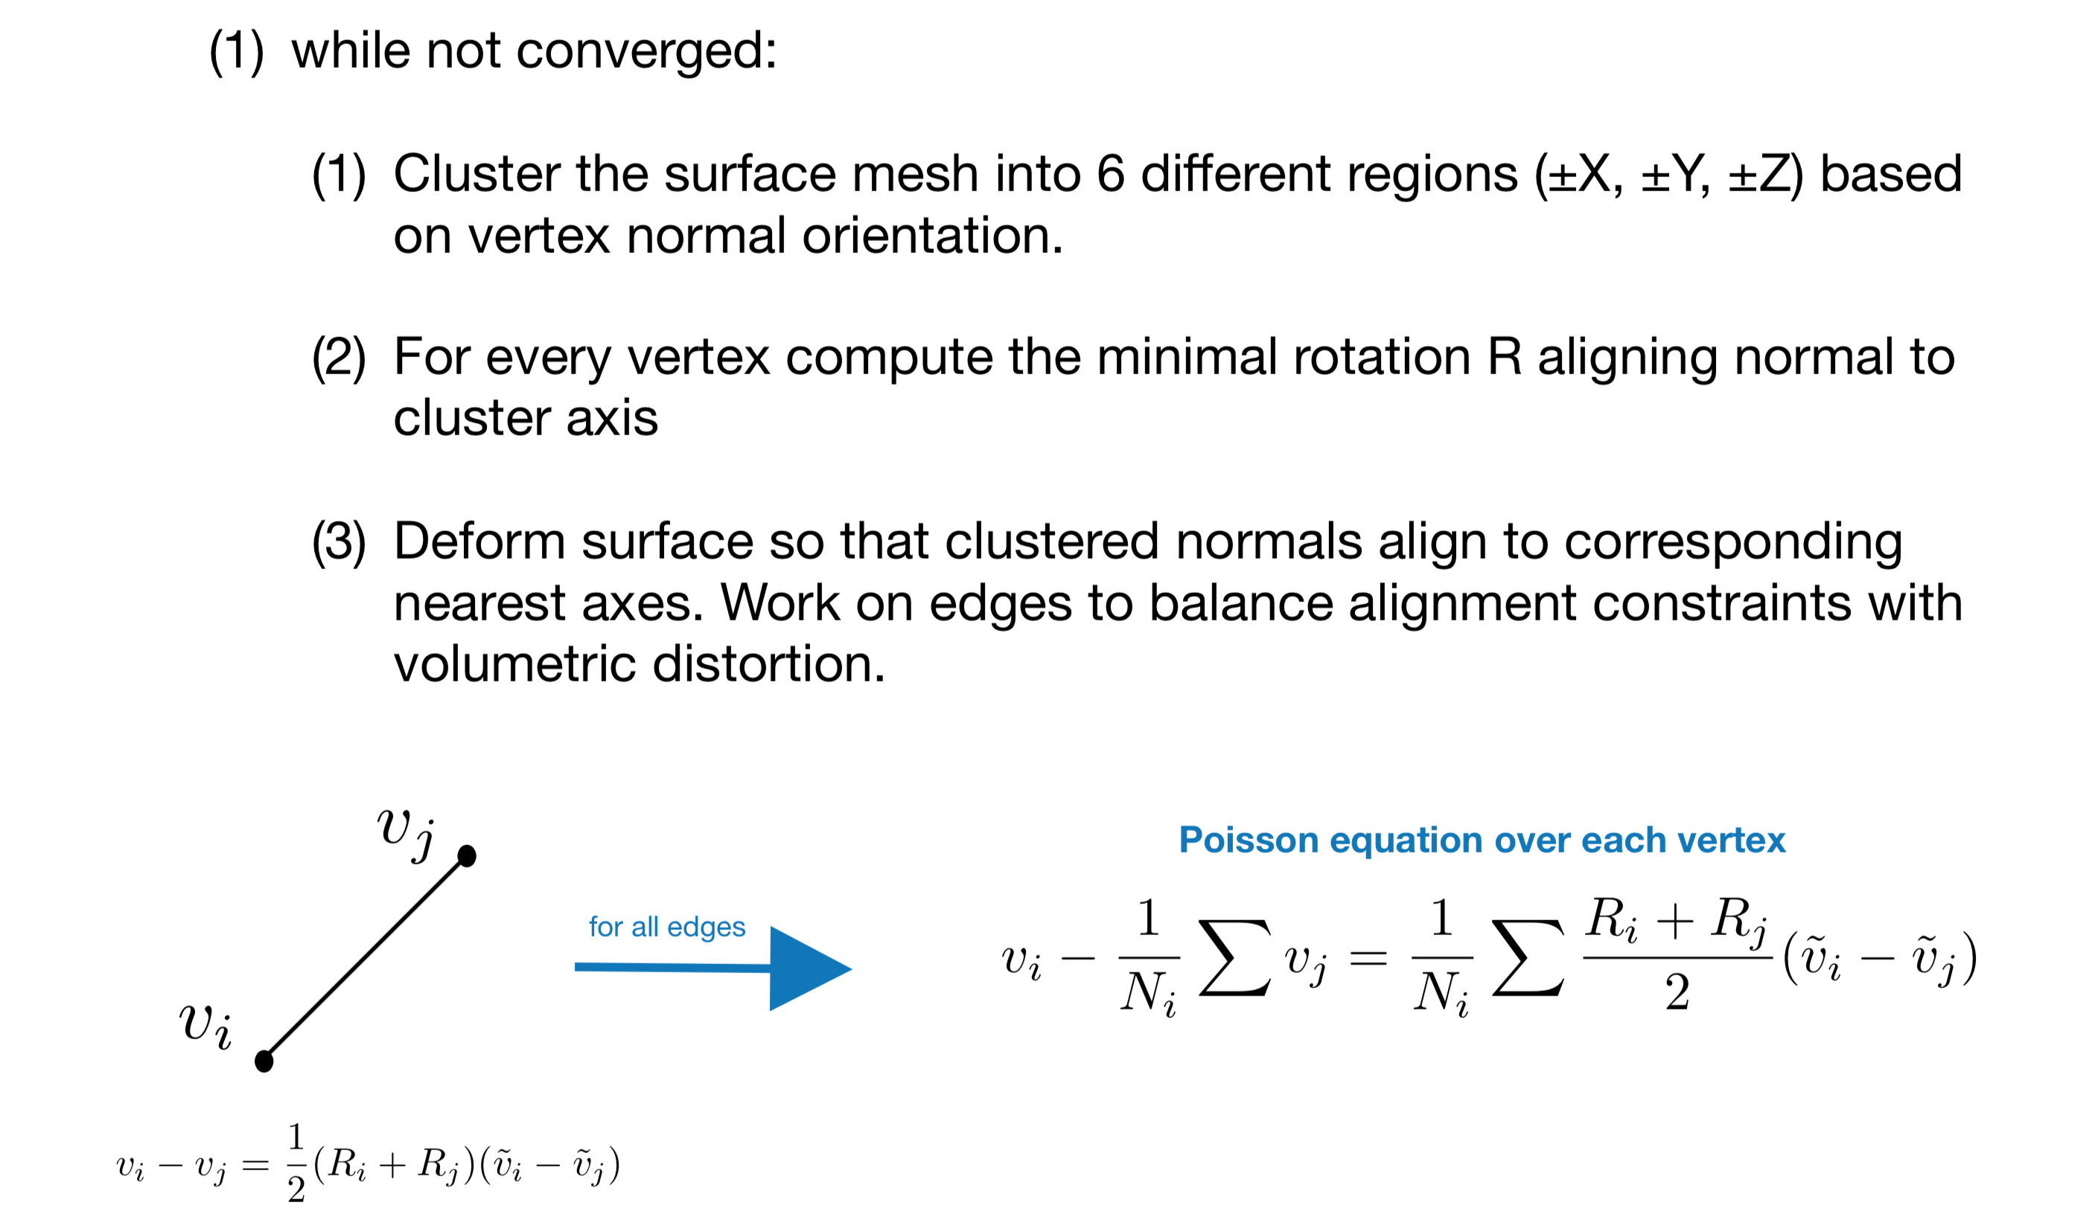
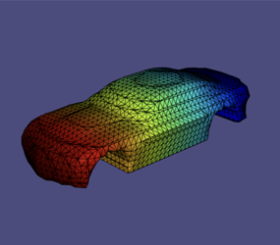
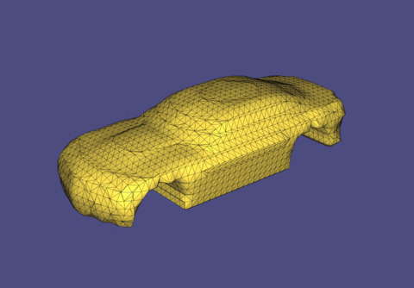
Step 1 - Axis Aligning Deformation
Iteratively deform a geometric model into a geometrically regular axis aligned shape
Algorithm
Results
Input
Original Mesh
Output
Axis Aligned Mesh
Notes:
AJOUTER DES ANIMATIONS POUR MONTRER LA DEFORMATION !!!!

Slide 8
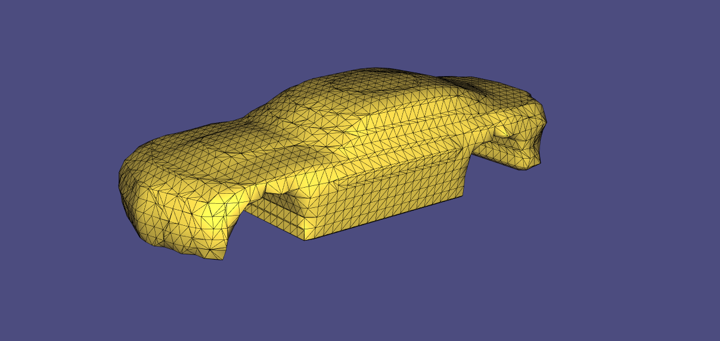
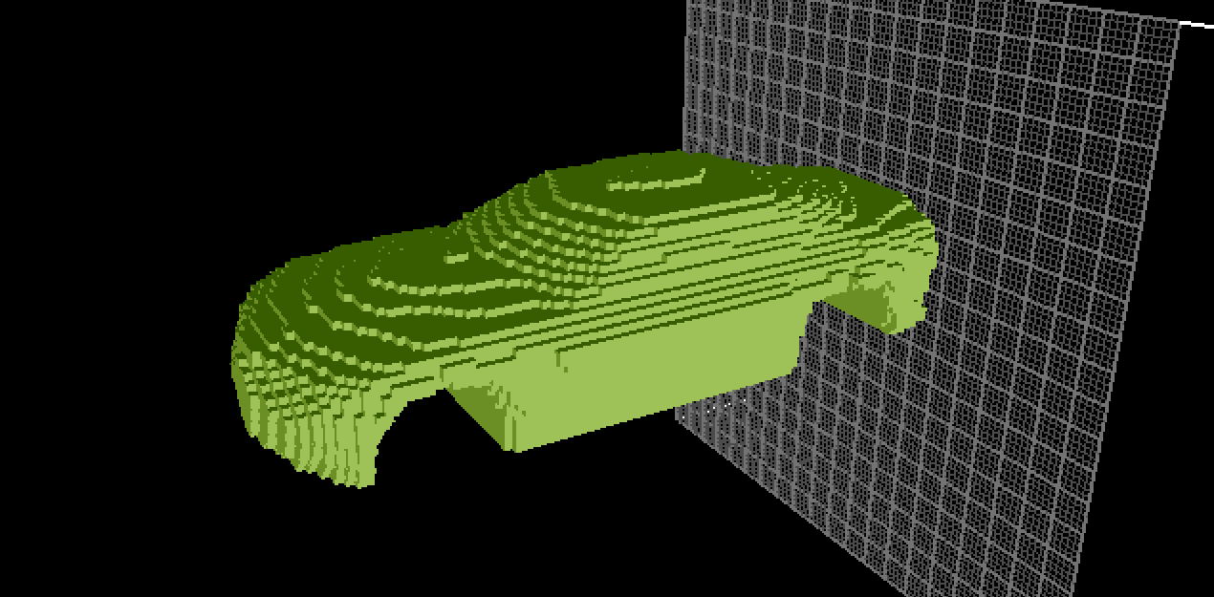
Step 2 - Volumetric Voxelization
Voxelize the axis aligned model by sampling the model’s signed distance function on a regular grid defined over the model’s bounding box
Input
Original Mesh
Input
Voxelized Mesh
Grid Size=100
Notes:
Since I had not prior knowledge on voxelization, it took quite some time to go in the littérature and to know a bit more about how to implement these algorithm is C++
Furtunately I found some codes pieces on github in order not to have to start from scratch (Libigl - Libigl is primarily licensed under MPL2 and used in many big companies like activision …)
Volumetric voxelization = we wanted to have voxels even inside not only at the boundaries
The conversion of the meshes to voxels enabled us come closer to the polycube structure that we wanted to have.

Slide 9
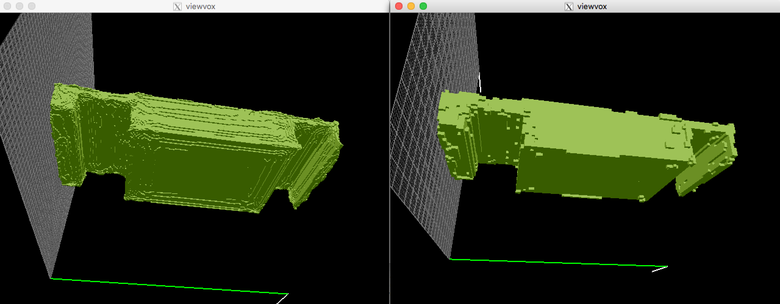
Results – Axis Aligning & Voxelization
Grid Size = 256
Grid Size = 100
Meshed Input
Output
Notes:
By putting the pieces together we get these results
One could play on the precision of the voxelization by tacking different grid sizes
However finer grid = higher complexity, more data and thus longer computation time
Nevertheless, we see that even if we are closer to a cubic car shape, that the shapes are not perfectly noiseless. Therefore, and as presented in the next part we used the hough Transform to correct these imperfections

Slide 10
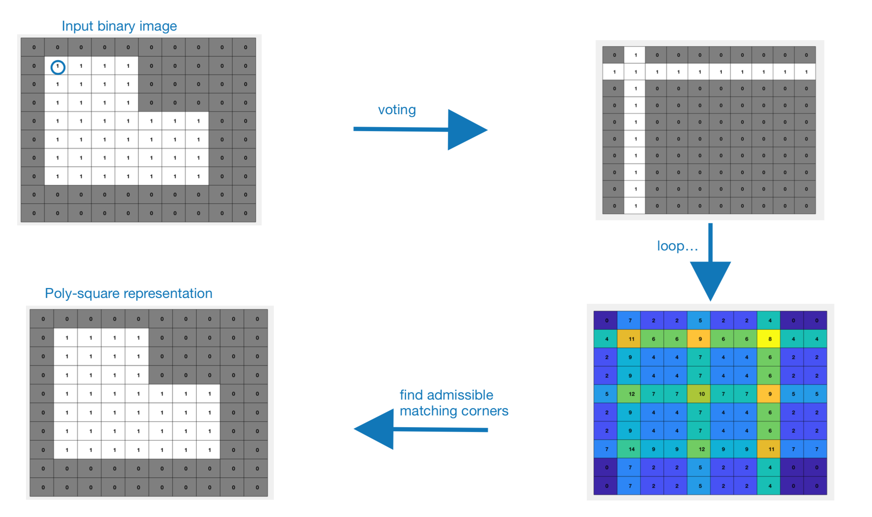
Step 3 - Hough Transform – 2D interpretation
Accumulator Space
Notes:
Dans la dernière étape c’est ce que nous avons expliqué avant: On définit le accumulator space
The corners end up to be the cells with the highest values. However not all the cells with the highest score are the real corners
Last step we control if the barycentre of the 3D struture is labelled a being a part of the strututure. If Yes we add the cube else we suppress it
As you will see in the next sldie there was a local voting which is based on the same principle but only increases the whole line and column locally and not everywhere

Slide 11
Step 3 - Hough Transform
Create the accumulator space, which is made up of a cell for each voxel, and set each cell to zero
Local Voting: for each boundary voxel (i,j,k) increment by 1 all cells that belong to the axis aligned planes centered in voxel (i,j,k) and to the neighborhood of the voxel
Search for local maxima in the accumulator space, these voxels represent the corners in the binary volume detected by the algorithm
Find polycubes in the domain by finding matching corners
Notes:
Hough transform is an “old school” computer vision method that we used to correct the shapes that we obtained from the voxelization algorithm
The purpose of the technique is to find imperfect instances of objects within a certain class of shapes by a voting procedure. This voting procedure is carried out in a parameter space, from which object candidates are obtained as local maxima in a so-called accumulator space that is explicitly constructed by the algorithm for computing the Hough transform.

Slide 12
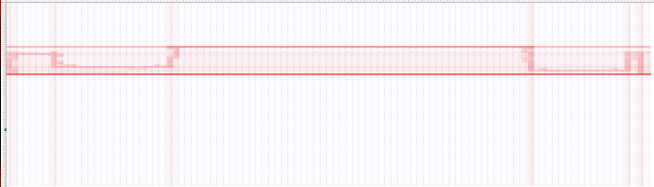
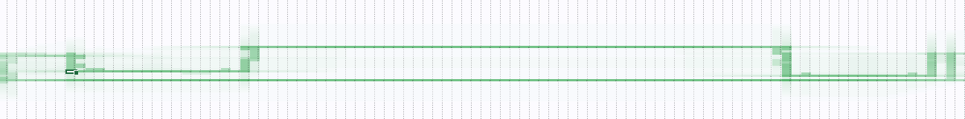
Voting – Applied to the car Problem
Voting
Local Voting
vs.
Notes:
Little improvement that I performed
Describe that the corners were easiier to find by doing so

Slide 13
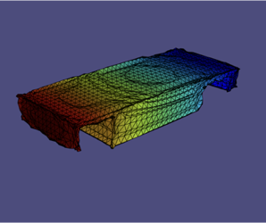
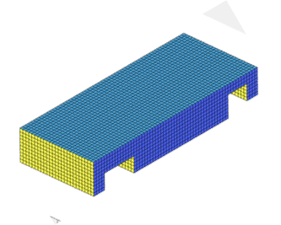
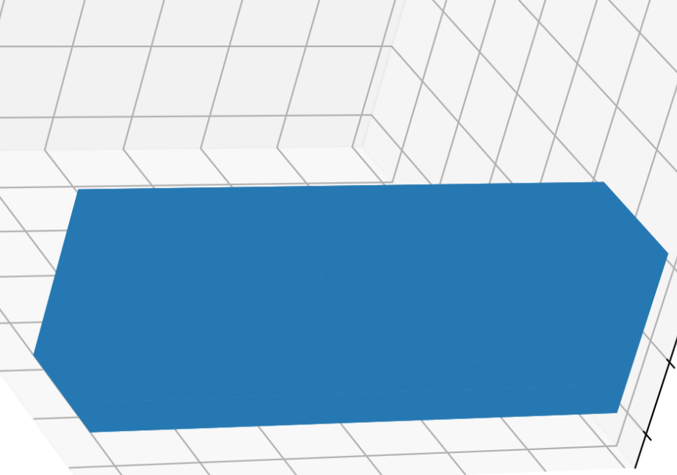
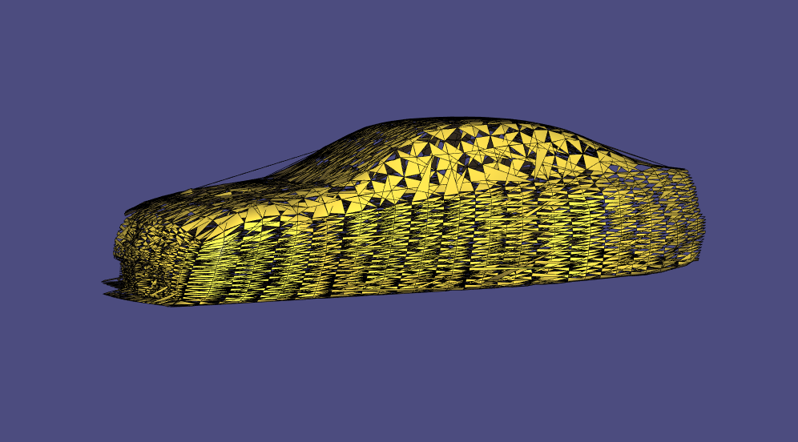
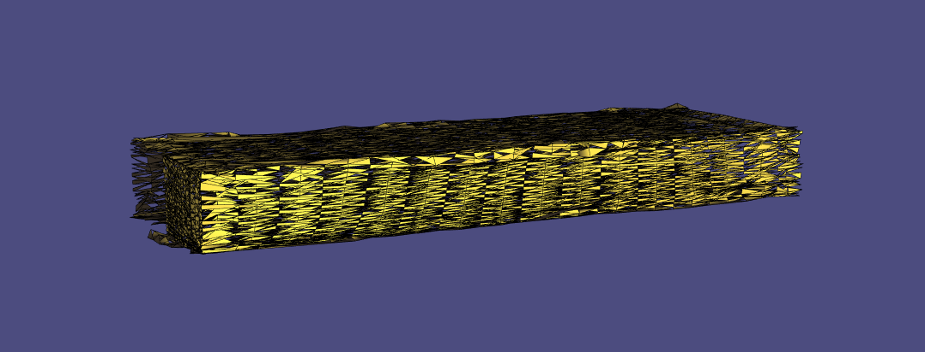
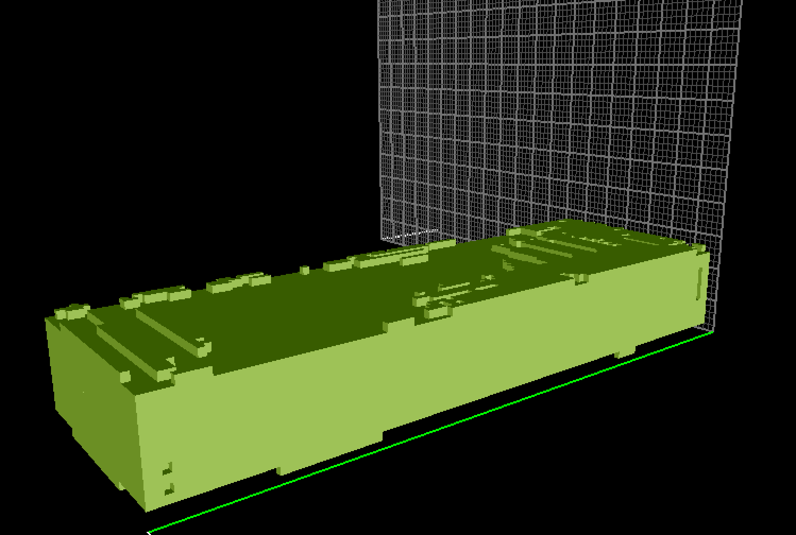
Results
.STL
Voxelization???
Mesh
Axis Aligned Mesh
Voxelized Axis Aligned Mesh
Polycube
.OBJ

Slide 14


Can we do this more efficiently?
3 different languages
Not the ideal languages for voxelization
Algorithmic complexity of the cubing process
Axis aligning
Voxelization
Hough Transform
…
Deep Learning?
Notes:
So far so good we were able to assemble all the single pieces in one, easy to use, efficient code in C++ #Happy
However we found no way to reduce the complexity of the cube generation …

Slide 15

Table of Content
Polycube Generation
Axis Aligning Deformation
Volumetric Voxelization
Hough Transform
Learn the Polycubing
3D U-Net
3D CNN
Notes:
ATTENTION: U-Net est un CNN mais avec des bridges
Donc le CNN était plus compliqué car il flalait faire de la feature extraction

Slide 16
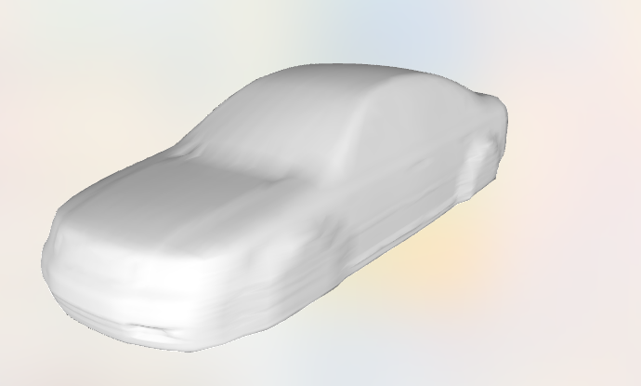
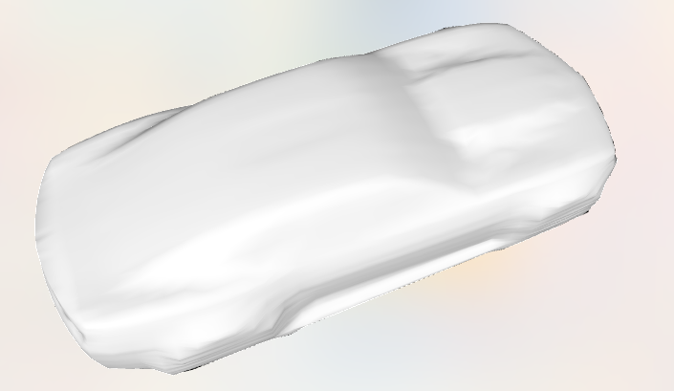
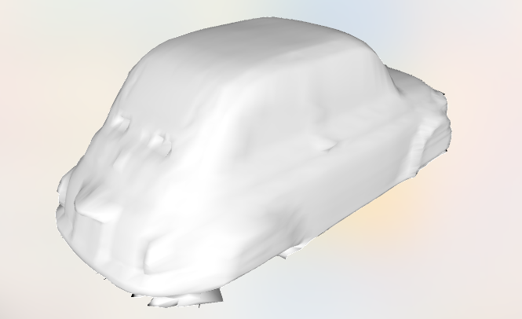
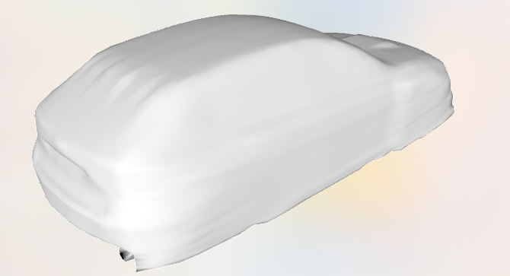
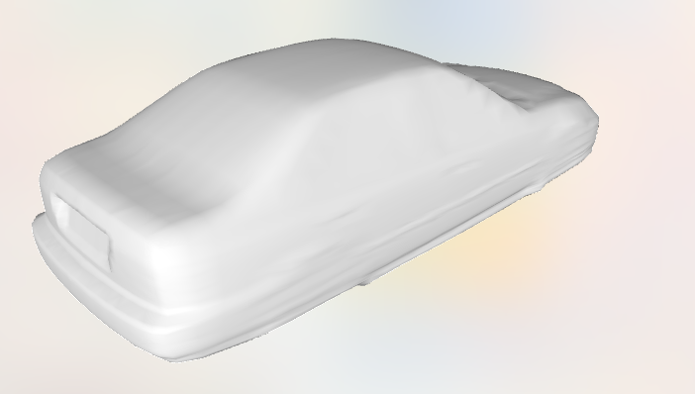
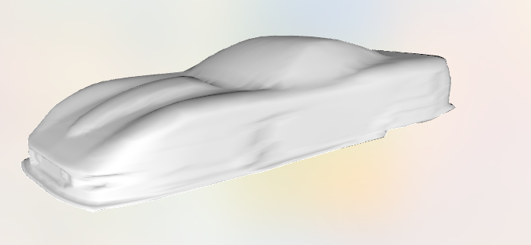
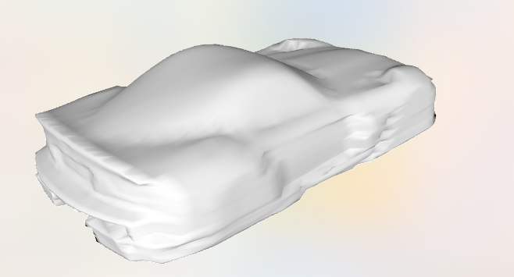
The Dataset
Raw Dataset: collection of 1221 obj files containing discretized shapes of cars
Notes:
- Faire une résumer de ce qu’on peut faire avec le SPA toolkit
Designed in python 2 but I upgraded it to python 3.
SPA Toolkit est la partie la plus longue du projet et donc c’est celle qui sera abordée avec le plus de details (et donc la plus longue)

Slide 17
The Dataset
Raw Dataset: collection of 1221 obj files containing discretized shapes of cars
C++ pipeline to generate polycubes
Voxelized meshes were used as input for the artificial neural network
Polycube structures used as the ground-truth of the training set
Input
Voxelized Mesh
Grid Size=100
Ground-Truth Polycube
Notes:
The raw dataset consisted of a collection of 1221 stereolithography (STL) files containing the discretized shapes of cars. These data was processed using the C++ pipeline that will be explained in the \textit{method} section. By using this program, one was able to generate a Polycube structure starting from the given STL files (Fig. \ref{fig:fig1} \& \ref{fig:fig2}). These Polycube structures were then used as the \textit{Ground-truth representation (GT)} files of the training set, whereas the given files were used as input for the artificial neural network that was developed.

Slide 18
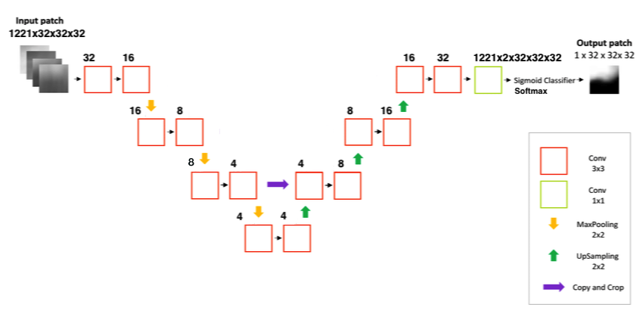
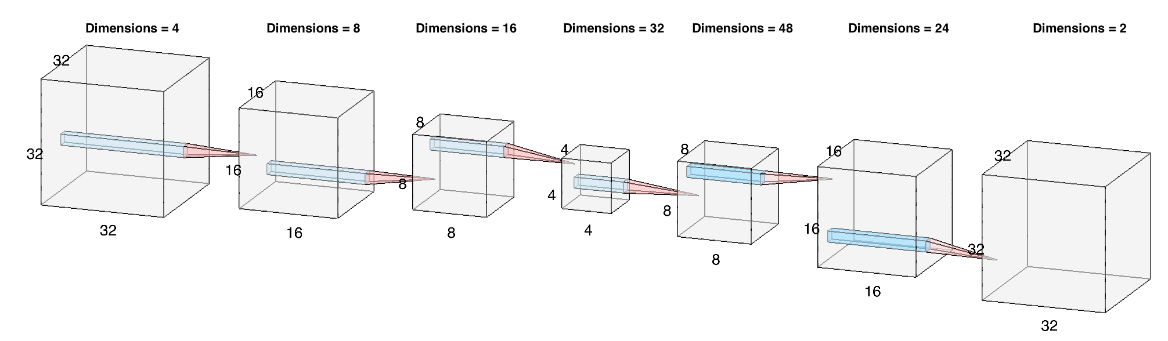
The U-Net Model
Sigmoid

Slide 19
Results - LeakyReLu Activation function
1111 Training shapes
100 Validation shapes
SOFTMAX
Activation in
last layer
SIGMOID
Activation in
last layer
Notes:
We tried a lot of things. The best performing model was … NEXT SLIDE
Once we had a good working architecture we tried to fine tune the the activation fucntion

Slide 20
Results - LeakyReLu Activation function
1111 Training shapes
100 Validation shapes
SIGMOID
Activation in
last layer
Notes:
Parler des résultats que maintenant
Different activation functions were used but LeakyRelu worked the best
Results for different optimizer were shown in the plot. As we can see we gotconsisted results all over the different experiments. This confirmed us that the architecture was good actually

Slide 21
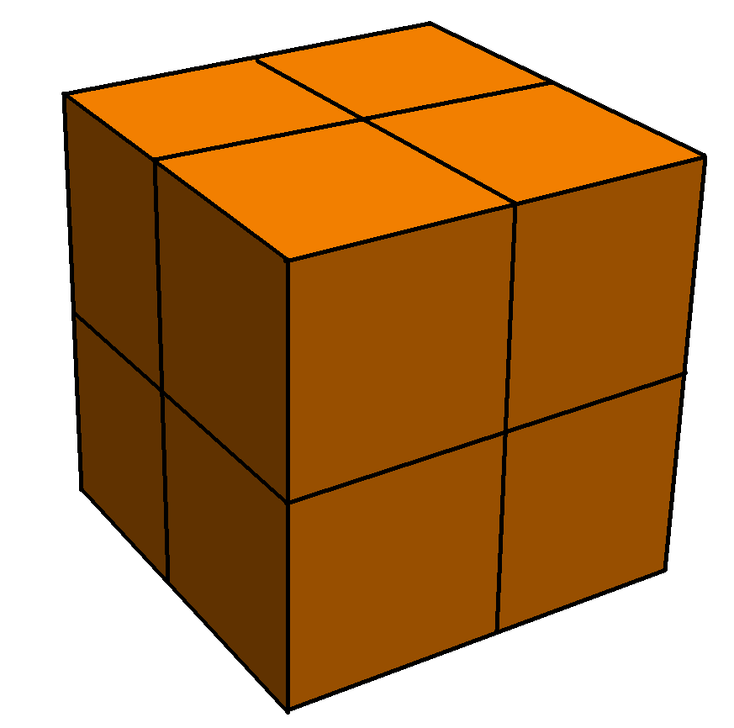
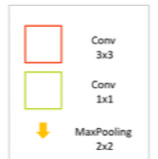
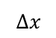
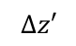
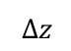
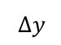
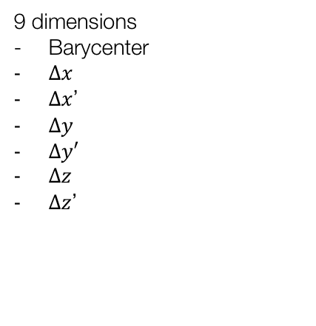
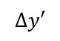
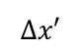
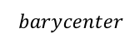
The CNN Model
4 Filters
8 Filters
$$barycenter$$
$$∆z$$
$$∆y$$
$$∆x′$$
16 Filters
$$∆y′$$
$$∆x$$
Legend
$$∆z′$$
9 dimensions
Barycenter
$∆x$
$∆x$’
$∆y$
$∆y′$
$∆z$
$∆z$’
FC
9d Output
Postprocessing
Notes:
The second technique that was used was to extract the most important features of a cubes anf to learn them instead of using a complex Unet with down and upsmapling
In this trial we used 3 different CNN layers with maxpooling with 2x2x2 windows and batchnorm as a regularizer
Finally everythin went through a FC layer and we used softmax to assign the final values to each feature
MSE as loss function
Leaky-Relu as Activation

Slide 22
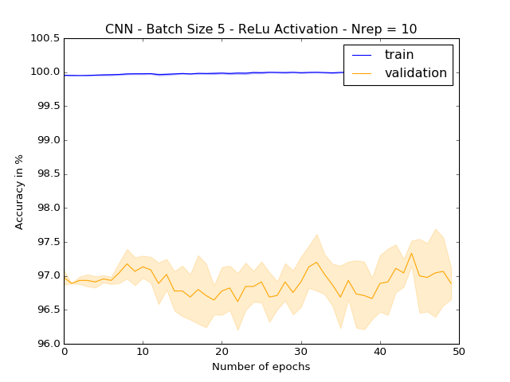
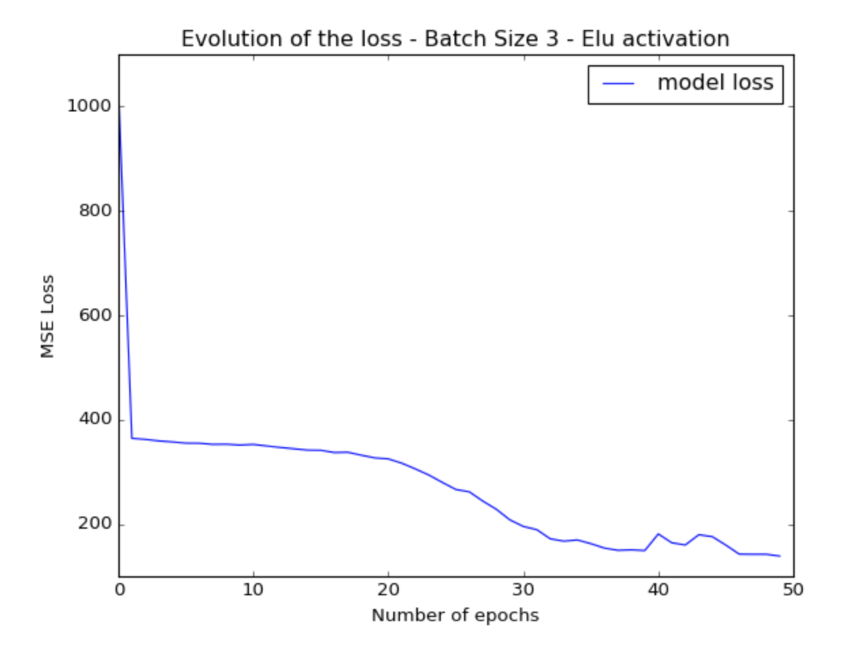
The CNN Model – Tuning Results
Notes:
The second technique that was used was to extract the most important features of a cubes anf to learn them instead of using a complex Unet with down and upsmapling
In this trial we used 3 different CNN layers with maxpooling with 2x2x2 windows and batchnorm as a regularizer
Finally everythin went through a FC layer and we used softmax to assign the final values to each feature
MSE as loss function
Leaky-Relu as Activation
Once we had a good working architecture we tried to fine tune the the activation fucntion

Slide 23
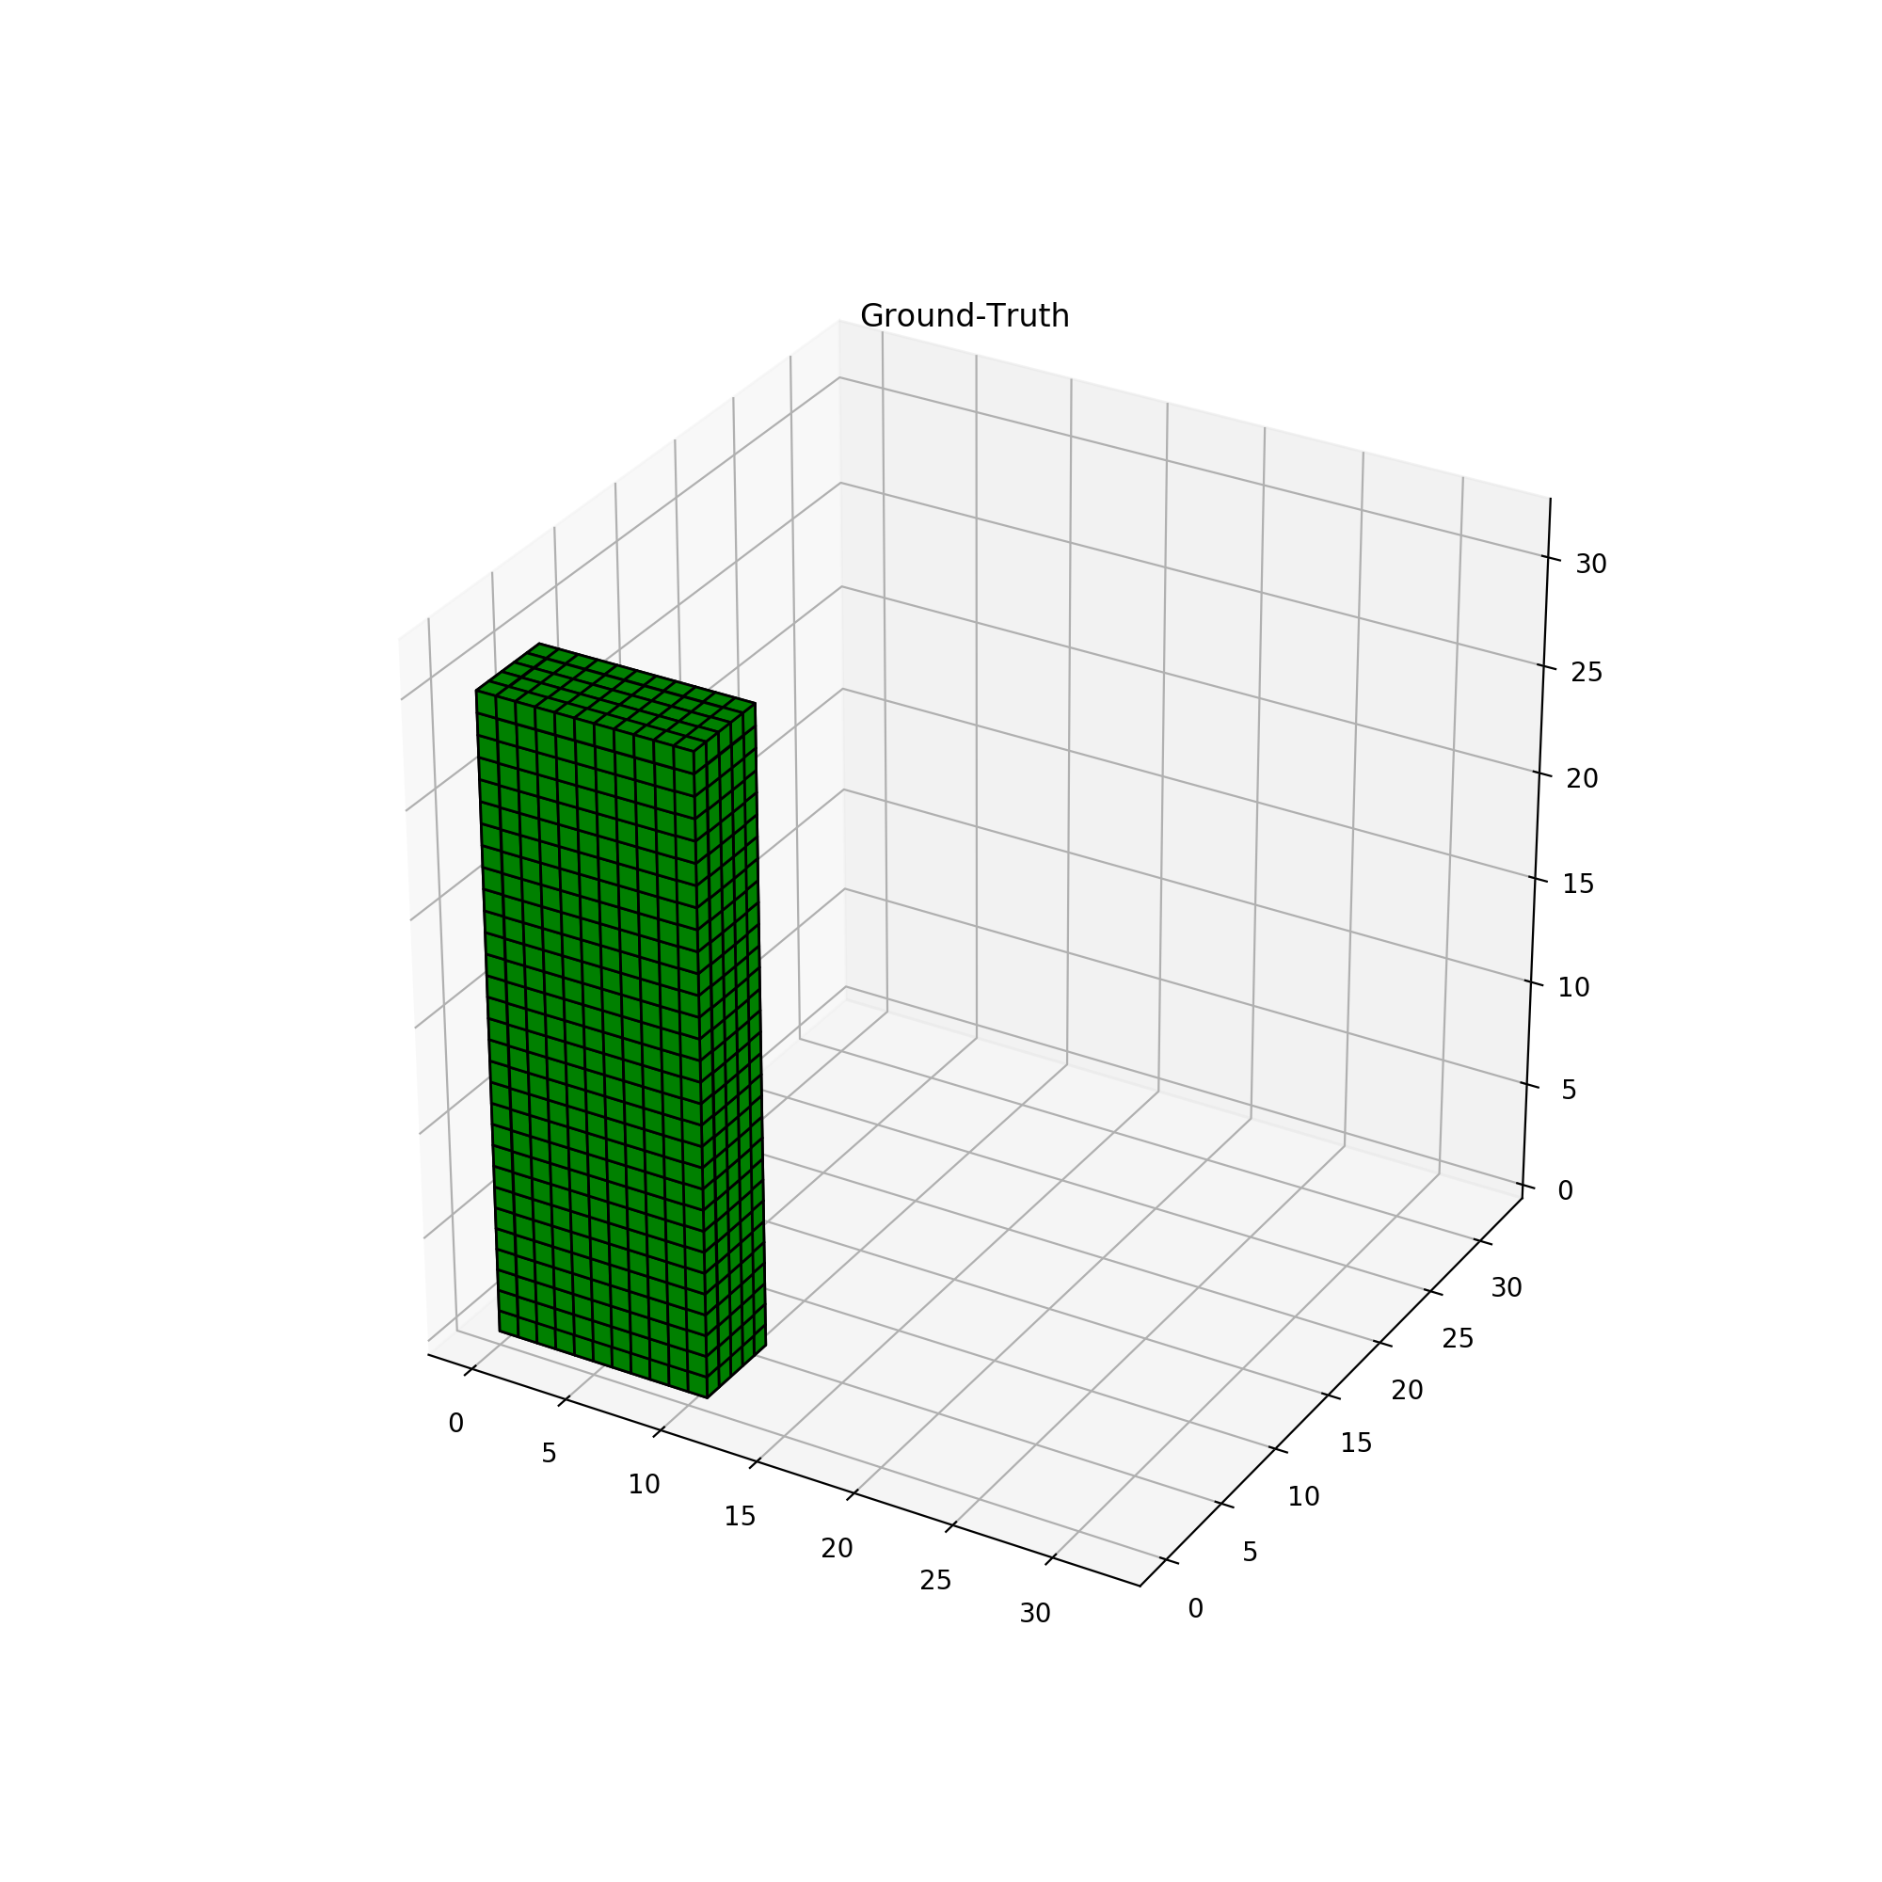
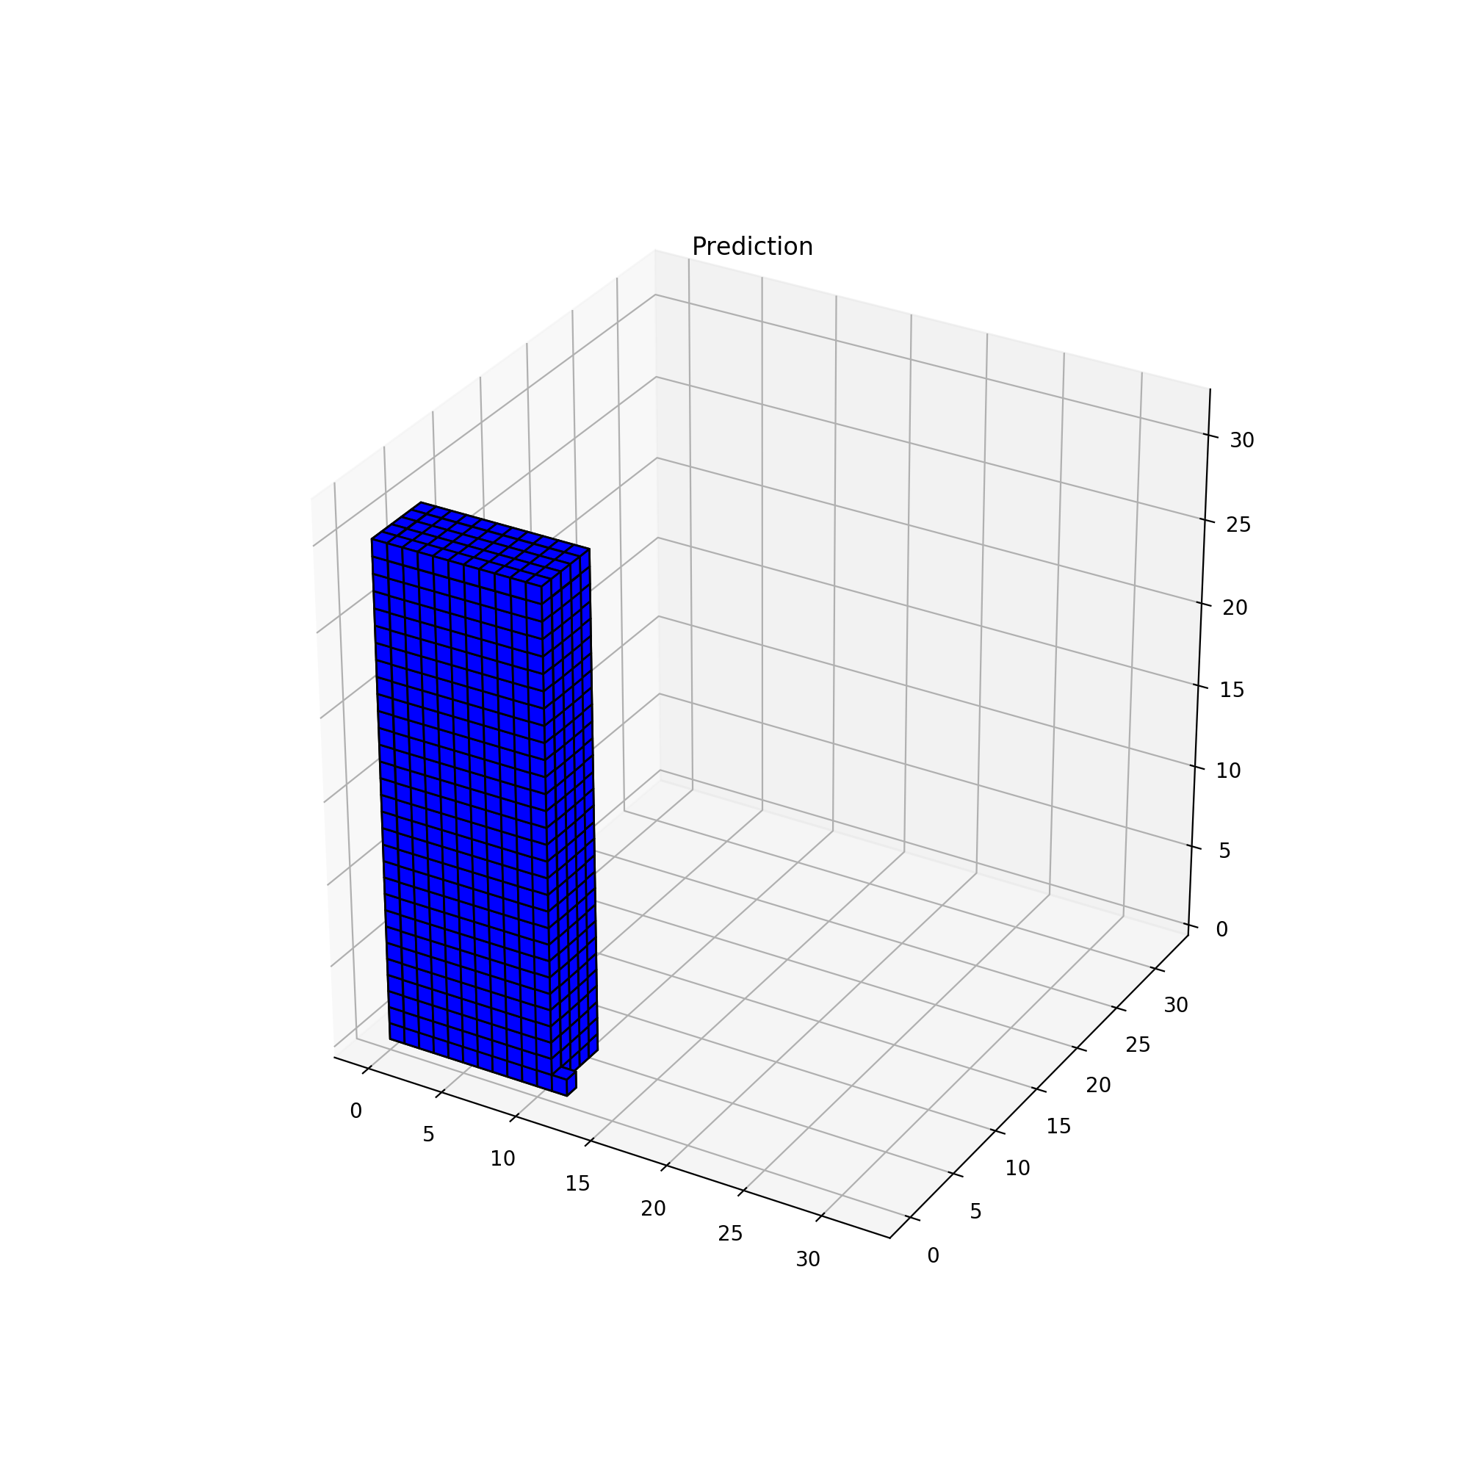

Summary - Unet vs. CNN
U-Net Method | CNN Method
Easy and fast to implement High accuracy Noise | High Accuracy No noise Needs preprocessing and postprocessing
U-Net output
CNN output
Notes:
Needs preprocessing and postprocessing in order to build the cubes again

Slide 24

Can we do this more efficiently?
3 different languages
Not the ideal languages for voxelization
Algorithmic complexity of the cubing process
Axis aligning
Voxelization
Hough Transform
…
CNN!
Notes:
So far so good we were able to assemble all the single pieces in one, easy to use, efficient code in C++ #Happy
However we found no way to reduce the complexity of the cube generation …

Slide 25
References
Baqué, P., Remelli, E., Fleuret, F., & Fua, P. (2018). Geodesic Convolutional Shape Optimization. Retrieved from http://arxiv.org/abs/1802.04016
Alliez, P. and Cohen-Steiner, D. and Tong, Y. and Desbrun, M. (2007). Voronoi-based variational reconstruction of unoriented point sets. Proceedings of the Fifth Eurographics Symposium on Geometry Processing, 39–48. https://doi.org/10.1145/1281991.1281997
Monti, F., Boscaini, D., Masci, J., Rodolà, E., Svoboda, J., & Bronstein, M. M. (2017). Geometric deep learning on graphs and manifolds using mixture model CNNs. Proceedings - 30th IEEE Conference on Computer Vision and Pattern Recognition, CVPR 2017, 2017–January, 5425–5434. https://doi.org/10.1109/CVPR.2017.576
Yu, W., Zhang, K., Wan, S., & Li, X. (2014). Optimizing polycube domain construction for hexahedral remeshing. CAD Computer Aided Design, 46(1), 58–68. https://doi.org/10.1016/j.cad.2013.08.018
Bommes, D., Campen, M., Ebke, H.-C., Alliez, P., & Kobbelt, L. (2013). Integer-grid maps for reliable quad meshing. ACM Transactions on Graphics, 32(4), 1. https://doi.org/10.1145/2461912.2462014
Bommes, D., Lévy, B., Pietroni, N., Puppo, E., Silva, C., Tarini, M., & Zorin, D. (2013). Quad-mesh generation and processing: A survey. Computer Graphics Forum, 32(6), 51–76. https://doi.org/10.1111/cgf.12014
Tarini, M. (2004). PolyCube-Maps. ACM Transactions on Graphics, 23(2), 853–860. https://doi.org/10.1145/1015706.1015810
Umetani, N. (2017). Exploring generative 3D shapes using autoencoder networks. SIGGRAPH Asia 2017 Technical Briefs on - SA ’17, 1–4. https://doi.org/10.1145/3145749.3145758

Slide 26

Questions ?

Slide 27


Slide 28



Project Timeline
Reading papers about voxelization techniques, shape simplification, polycubes, computer vision, …
Automatic Polycube Generation for car shapes = Generation of the dataset for step 5
Step 2
Step 4
Step 1
Step 3
Step 5
Set-up meetings with Edoardo
Getting started on meshes
Training a deep neural network to learn the cubification
Implementation of the solid voxelization

Slide 29
Results – LeakyReLu Activation function – Light Model

Slide 30
Results – ReLu Activation function – Light Model

Slide 31
Results – Sigmoid Activation function – Light Model

Slide 32
Preprocessing
Split data in Training and Validation set
1111 Training shapes
100 Validation shapes

Slide 33
The CNN Model – Results
Notes:
The second technique that was used was to extract the most important features of a cubes anf to learn them instead of using a complex Unet with down and upsmapling
In this trial we used 3 different CNN layers with maxpooling with 2x2x2 windows and batchnorm as a regularizer
Finally everythin went through a FC layer and we used softmax to assign the final values to each feature
MSE as loss function
Leaky-Relu as Activation

